Slide 1
Lesson 15
Query Performance

Slide 2
Main performance killers
Insufficient indexing
Inaccurate statistics
Improper query design
Poorly generated execution plans
Excessive blocking and deadlocks
Non-set-based operations, usually T-SQL cursors
Inappropriate database design
Excessive fragmentation
Nonreusable execution plans
Frequent recompilation of queries
Improper use of cursors
Improper configuration of the database transaction log
Excessive use or improper configuration of tempdb

Slide 3
Tuning Queries
Tuning queries is the process of optimizing performance to meet business requirements.

Slide 4
Measuring Performance
SQL Server uses three main metrics to measure performance
Query Cost
Page Reads
Query Execution Time.

Slide 5
1) Query Cost
Query Cost is an internal metric that takes into account CPU and I/O resources used by the query
The lower the Query Cost the better the query performance is
The query cost is not affected by issues such as resource contention or waiting for locks
The cost of UDFs and CLR routines is not calculated

Slide 6
2) Page Reads
Page reads represents the number of 8KB data pages accessed while executing a query
SET STATISTICS IO ON causes each query execution to output a statistical data in Messages tab
Use DBCC DROPCLEANBUFFERS to clear data from the cache.

Slide 7
Output item | Description
Table | Name of the table.
Scan count | Number of index or table scans performed.
logical reads | Number of pages read from the data cache.
physical reads | Number of pages read from disk.
read-ahead reads | Number of pages placed into the cache for the query.
lob logical reads | Number of text, ntext, image, or large value type (varchar(max), nvarchar(max), varbinary(max)) pages read from the data cache.
lob physical reads | Number of text, ntext, image or large value type pages read from disk.
lob read-ahead reads | Number of text, ntext, image or large value type pages placed into the cache for the query.

Slide 8
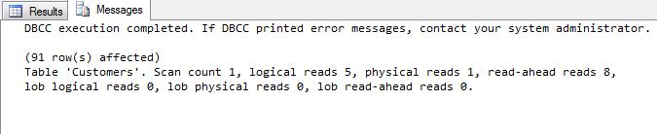
SET STATISTICS IO ON;
DBCC DropCleanBuffers
Select * from sales.Customers

Slide 9
3) Query Execution Time
The execution time of the query is affected by blocking (locks), as well as resource contention on the server
SET STATISTICS TIME ON outputs the execution time in milliseconds for each query execution.

Slide 10
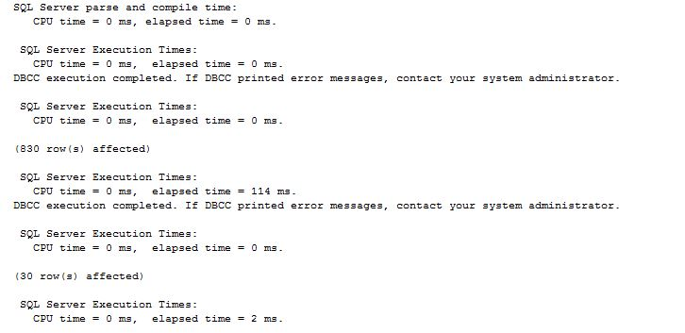
USE TSQL2012
SET STATISTICS TIME ON;
DBCC DROPCLEANBUFFERS
SELECT C.custid, C.companyname, O.orderid, O.orderdate
FROM Sales.Customers AS C
INNER JOIN Sales.Orders AS O ON C.custid = O.custid;
DBCC DROPCLEANBUFFERS;
SELECT C.custid, C.companyname, O.orderid, O.orderdate
FROM Sales.Customers AS C
INNER JOIN Sales.Orders AS O ON C.custid = O.custid
WHERE O.custid < 5;

Slide 11
Tuning Query Performance
Optimization consists of tasks such as
Rewriting the query
De-normalizing or normalizing tables
Adding indexes
Removing indexes

Slide 12
Graphical Execution Plan
This is a graphical tool useful for optimizing queries
To display the plan use Display Estimated Execution Plan or the Include Actual Execution Plan from Query menu item or by right clicking the query
The result is displayed in new tab
It can be saved as .SqlPlan file
To tune poorly performing queries identify the highest cost batch and then determine alternatives

Slide 13
Guidelines
Read execution plans right to left and top to bottom
Use the + symbol in the bottom-right corner to navigate large plans
Mouse-over each step to get more information
Mouse-over connecting lines to see details such as number of rows transferred
The heavier weight connecting lines indicate more rows moved
Where a query consists of multiple batches, investigate the most expensive batch first

Slide 14




Items to watch | Description
Thick arrow | A thick arrow represents a large number of rows moving from one operation in the execution plan to another.
Hash Match | If a hash operation is used to handle clauses such as GROUP BY and JOIN, it often means that an appropriate index did not exist to optimize the query.
Sort | If it is a high percentage of the query cost, you should consider whether an index can be built to remove the need for the sort operation.
Table or clustered index scans | A clustered index scan and a table scan indicate that no appropriate index can be used to optimize the query.
http://msdn.microsoft.com/en-us/library/ms175913(v=sql.105).aspx

Slide 15
Using Search Arguments
A search argument (SARG) is a filter expression that is used to limit the number of rows returned by a query and that can use an index seek operation
A filter expression is not a SARG if the column from the table is used in an expression (such as LEFT(Name, 1) = 'A')
If the filter is not a SARG and no other SARGs exist in the query, this results in an index or table scan

Slide 16
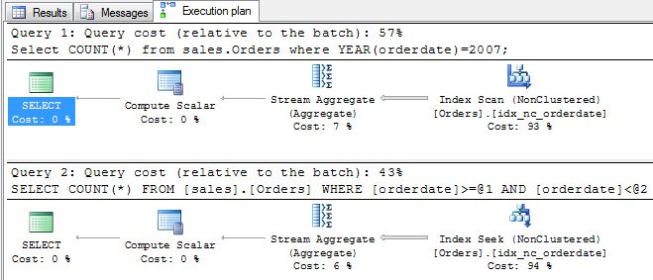
Use TSQL2012
Select COUNT(*) from sales.Orders where YEAR(orderdate)=2007;
Select COUNT(*) from sales.Orders where orderdate>='20070101' and orderdate <'20080101'
Scan
Seek

Slide 17
Using Joins
Minimize the number of join clauses used
Outer joins incur more cost than inner joins
The behavior of the ON and WHERE clauses is the same in Inner Joins

Slide 18
-- Query 1
SELECT p.ProductID, p.Name, sod.SalesOrderID
FROM Production.Product AS p
INNER JOIN Sales.SalesOrderDetail AS sod
ON sod.ProductID = p.ProductID
WHERE p.Color = 'Black';
-- Query 2
SELECT p.ProductID, p.Name, sod.SalesOrderID
FROM Production.Product AS p
INNER JOIN Sales.SalesOrderDetail AS sod
ON sod.ProductID = p.ProductID
AND p.Color = 'Black';
The performance of the two queries is the same

Slide 19
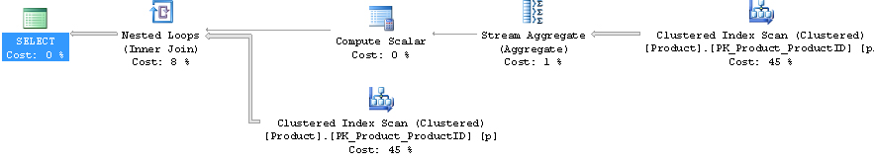
Non Correlated Subqueries
A Non-correlated subquery is executed only once per query and returns only one value
-- All products that are more expensive than avg SELECT p.ProductID ,p.Name ,p.ListPrice
FROM Production.Product AS p
WHERE p.ListPrice > (
SELECT AVG(p2.ListPrice)
FROM Production.Product AS p2
);

Slide 20
Correlated Subqueries
A correlated subquery which uses EXISTS to filter the outer query is equal in performance compared to using a JOIN
--Products Than have been sold
SELECT p.ProductID, p.Name
FROM Production.Product AS p
WHERE EXISTS (
SELECT * FROM Sales.SalesOrderDetail AS sod
WHERE sod.ProductID = p.ProductID
)
GO
SELECT Distinct p.ProductID, p.Name
FROM Production.Product AS p
Join Sales.SalesOrderDetail as sod
on sod.ProductID = p.ProductID

Slide 21
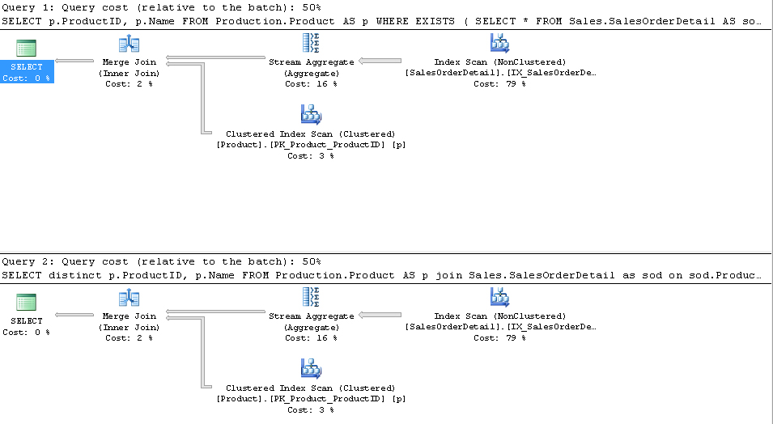

Slide 22
If a large number of rows are returned by the outer query, subquery would be executed for each row, so that means a large number of query executions
SELECT
soh.SalesOrderID, soh.OrderDate
,(SELECT TOP(1) sod1.UnitPrice
FROM Sales.SalesOrderDetail AS sod1
WHERE sod1.SalesOrderID = soh.SalesOrderID
ORDER BY sod1.OrderQty DESC
) AS UnitPrice
,(SELECT TOP(1) sod2.OrderQty
FROM Sales.SalesOrderDetail AS sod2
WHERE sod2.SalesOrderID = soh.SalesOrderID
ORDER BY sod2.OrderQty DESC
) AS OrderQty
FROM Sales.SalesOrderHeader AS soh
WHERE soh.TerritoryID = 4;
6224+6224 execution
6224 Rows

Slide 23
SELECT
soh.SalesOrderID
,soh.OrderDate
,a.*
FROM Sales.SalesOrderHeader AS soh
OUTER APPLY (
SELECT TOP(1)
sod.UnitPrice
,sod.OrderQty
FROM Sales.SalesOrderDetail AS sod
WHERE sod.SalesOrderID = soh.SalesOrderID
ORDER BY sod.OrderQty DESC
) AS a
WHERE soh.TerritoryID = 4;
6224 execution

Slide 24
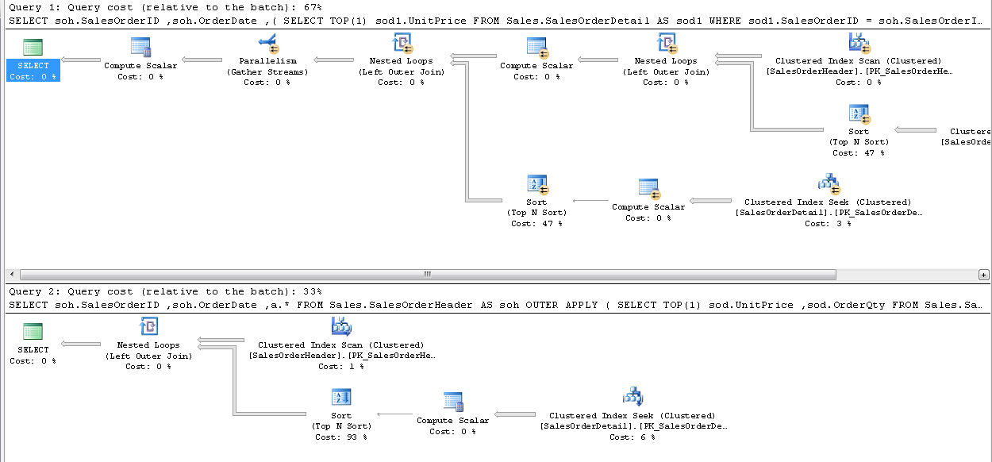

Slide 25
Scalar UDFs
UDFs can significantly degrade performance because these functions are not expanded and optimized into the main query plan by the optimizer
The cost of whatever is done inside the functions is not included in the cost estimates found in the graphical execution plan for the query
The appropriate performance metric for queries using UDFs is the execution time, which is returned using the SET STATISTICS TIME ON

Slide 26
USE AdventureWorks;
GO
CREATE FUNCTION dbo.fnGetCustomerAccountNumber(@CustomerID INT)
RETURNS VARCHAR(10)
AS
BEGIN
RETURN ISNULL(
(
SELECT AccountNumber
FROM Sales.Customer
WHERE CustomerID = @CustomerID ), 'NOT FOUND');
END
GO
SET STATISTICS IO ON;
SET STATISTICS TIME ON;
SELECT
soh.SalesOrderID
,soh.OrderDate
,dbo.fnGetCustomerAccountNumber(soh.CustomerID)
FROM Sales.SalesOrderHeader AS soh;

Slide 27
USE AdventureWorks;
SET STATISTICS IO ON;
SET STATISTICS TIME ON;
SELECT
soh.SalesOrderID
,soh.OrderDate
,ISNULL(
(
SELECT
AccountNumber
FROM Sales.Customer
WHERE CustomerID = soh.CustomerID
), 'NOT FOUND')
FROM Sales.SalesOrderHeader AS soh;

Slide 28
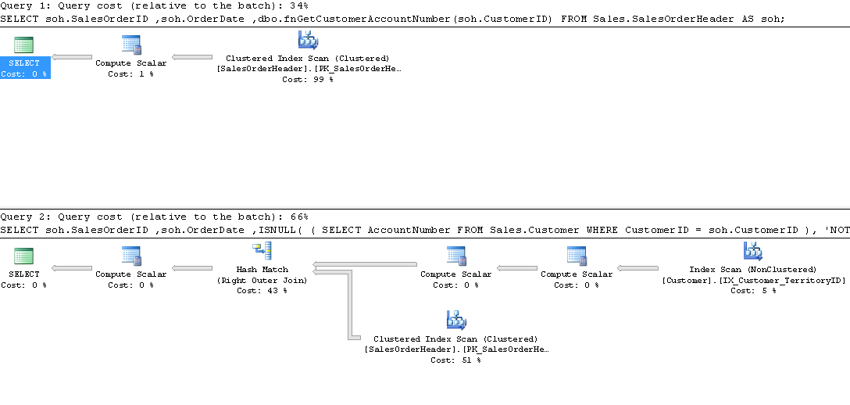
Query Cost did not take function into account

Slide 29
SQL Server Profiler
SQL Server Profiler is used to listen for events that occur on a SQL Server instance
For tuning, we typically use SQL:BatchCompleted and RPC:Completed events

Slide 30
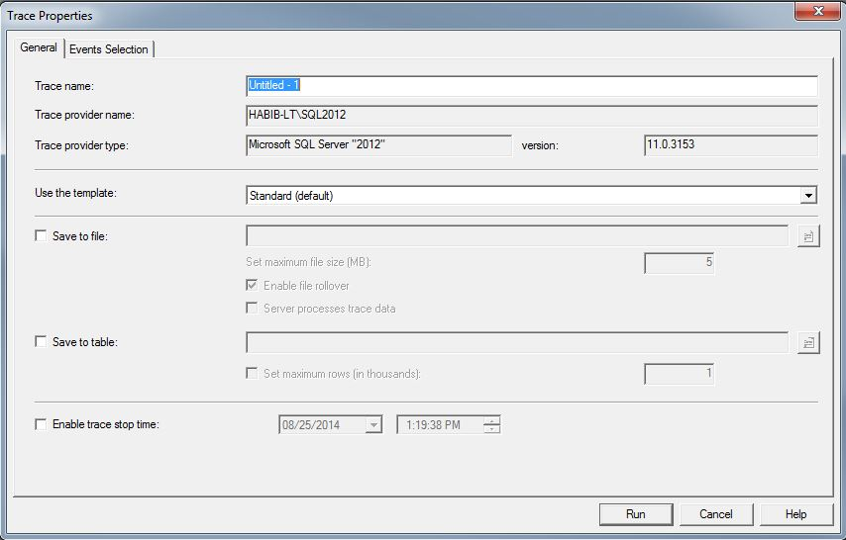

Slide 31
Useful columns for tuning are:
Duration Returns the number of milliseconds
Reads Returns the total number pages read during execution
Writes Returns the total number of written during execution
CPU Returns the total CPU time used during execution

